Slide 1
Basic Electrical Technology [ELE 1051]
Chapter 3 – PARALLEL AC Circuits

Slide 2
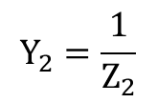




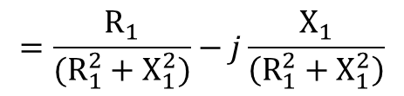


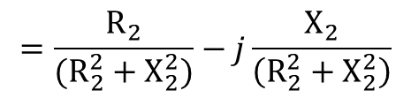


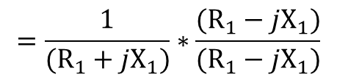



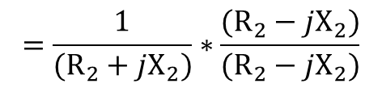


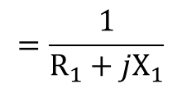


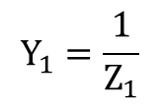
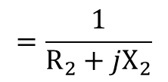


Impedance in parallel
Let
$$Z_{1}=R_{1}+jX_{1}$$
$$Z_{2}=R_{2}+jX_{2}$$
$$I$$
$$I_{1}$$
$$I_{2}$$
$$\frac{1}{Z_{eq}}=\frac{1}{Z_{1}}+\frac{1}{Z_{2}}$$
$$I_{1}=I∗\frac{Z_{2}}{Z_{1}+Z_{2}}$$
$$I_{2}=I∗\frac{Z_{1}}{Z_{1}+Z_{2}}$$
$$V∠0°$$
$$Z_{1}$$
$$Z_{2}$$
$$Y_{eq}=Y_{1}+Y_{2}$$
$$Y: Admittance$$
$$Y_{1}=\frac{1}{Z_{1}}$$
$$=\frac{1}{R_{1}+jX_{1}}$$
$$=\frac{1}{(R_{1}+jX_{1})}∗\frac{(R_{1}−jX_{1})}{(R_{1}−jX_{1})}$$
$$=\frac{R_{1}}{(R_{1}^{2}+X_{1}^{2})}−j\frac{X_{1}}{\left(R_{1}^{2}+X_{1}^{2}\right)}$$
$$=G_{1}−jB_{1}$$
$$Y_{2}=\frac{1}{Z_{2}}$$
$$=\frac{1}{R_{2}+jX_{2}}$$
$$=\frac{1}{(R_{2}+jX_{2})}∗\frac{(R_{2}−jX_{2})}{(R_{2}−jX_{2})}$$
$$=\frac{R_{2}}{(R_{2}^{2}+X_{2}^{2})}−j\frac{X_{2}}{\left(R_{2}^{2}+X_{2}^{2}\right)}$$
$$=G_{2}−jB_{2}$$
$$G: Conductance$$
$$B: Susceptance$$
$$Y_{eq}=\left(G_{1}+G_{2}\right)−j\left(B_{1}+B_{2}\right)=G_{eq}−jB_{eq}$$

Slide 3


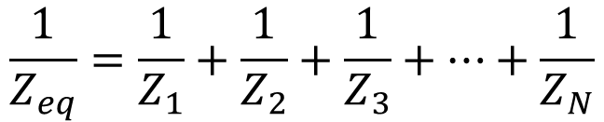










Impedance in parallel
For ‘N’ impedances connected in parallel,
$$\frac{1}{Z_{eq}}=\frac{1}{Z_{1}}+\frac{1}{Z_{2}}+\frac{1}{Z_{3}}+…+\frac{1}{Z_{N}}$$
$$I$$
$$I_{1}$$
$$I_{2}$$
$$I_{3}$$
$$I_{N}$$
$$Y_{eq}=Y_{1}+Y_{2}+Y_{3}+…+Y_{N}$$
$$Z_{1}$$
$$Z_{2}$$
$$Z_{3}$$
$$Z_{N}$$
$$Y_{eq}=G_{eq}±jB_{eq}$$
$$I_{1}=VY_{1};I_{2}=VY_{2};I_{3}=VY_{3};……I_{N}=VY_{N}$$
$$I=I_{1}+I_{2}+I_{3}+…+I_{N}=VY_{eq}$$

Slide 4

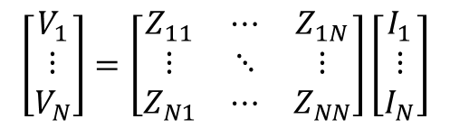

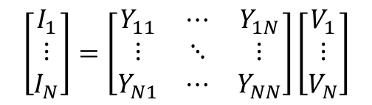
Network equations for AC circuits
$$\left[\begin{matrix}V_{1} \\ \begin{matrix}⋮ \\ V_{N}\end{matrix}\end{matrix}\right]=\left[\begin{matrix}Z_{11} & ⋯ & Z_{1N} \\ ⋮ & ⋱ & ⋮ \\ Z_{N1} & ⋯ & Z_{NN}\end{matrix}\right]\left[\begin{matrix}I_{1} \\ ⋮ \\ I_{N}\end{matrix}\right]$$
KVL Equation
(Matrix form)
$$\left[V\right]=\left[Z\right]\left[I\right]$$
KCL Equation
(Matrix form)
$$\left[\begin{matrix}I_{1} \\ \begin{matrix}⋮ \\ I_{N}\end{matrix}\end{matrix}\right]=\left[\begin{matrix}Y_{11} & ⋯ & Y_{1N} \\ ⋮ & ⋱ & ⋮ \\ Y_{N1} & ⋯ & Y_{NN}\end{matrix}\right]\left[\begin{matrix}V_{1} \\ ⋮ \\ V_{N}\end{matrix}\right]$$
$$\left[I\right]=\left[Y\right]\left[V\right]$$
All the other theorems are applicable to the AC circuits

Slide 5
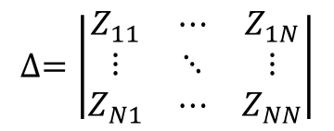
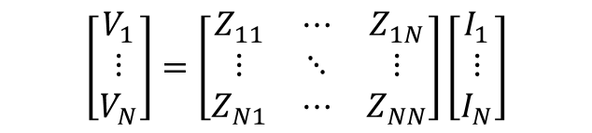

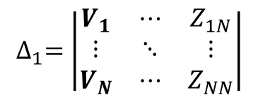
Crammers rule
$$\left[\begin{matrix}V_{1} \\ \begin{matrix}⋮ \\ V_{N}\end{matrix}\end{matrix}\right]=\left[\begin{matrix}Z_{11} & ⋯ & Z_{1N} \\ ⋮ & ⋱ & ⋮ \\ Z_{N1} & ⋯ & Z_{NN}\end{matrix}\right]\left[\begin{matrix}I_{1} \\ ⋮ \\ I_{N}\end{matrix}\right]$$
Solution for the linear simultaneous equations above is as follows
Step 1: finding the determinant
$$∆=\left|\begin{matrix}Z_{11} & ⋯ & Z_{1N} \\ ⋮ & ⋱ & ⋮ \\ Z_{N1} & ⋯ & Z_{NN}\end{matrix}\right|$$
Step 2: finding the determinant after substituting first column with RHS column matrix
$$∆_{1}=\left|\begin{matrix}V_{1} & ⋯ & Z_{1N} \\ ⋮ & ⋱ & ⋮ \\ V_{N} & ⋯ & Z_{NN}\end{matrix}\right|$$
Step 3 :Solution for I₁
$$I_{1}=\frac{∆_{1}}{∆}$$

Slide 6
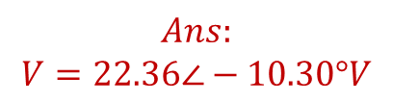
Illustration 1
Assigning two mesh currents, find the voltage V across the capacitor in the following circuit
$$Ans:$$
$$V=22.36∠−10.30°V$$

Slide 7

Illustration 2
Use node voltage method to obtain the current I in the network
$$Ans:$$
$$I=12.38∠−17.75° A$$
Notes:
Schaum's Outline of Electric Circuits 4E (Mahmood Nahvi & Josepf Edminister)
Page 209; Problem 9.21

Slide 8

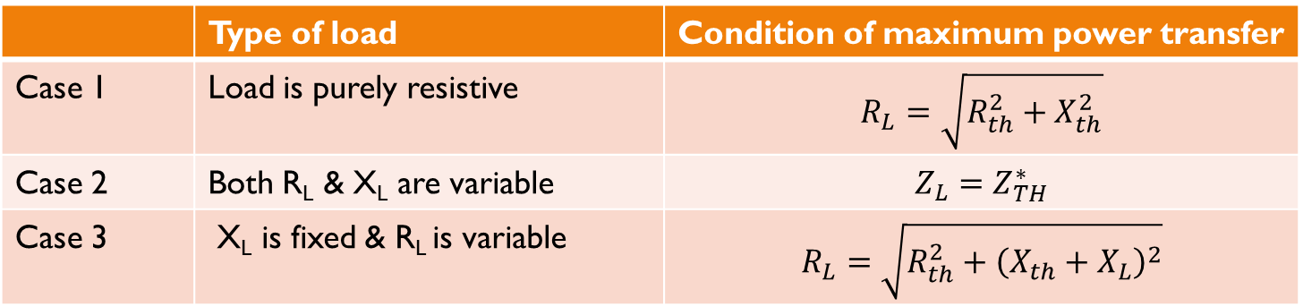


Maximum power transfer theorem
$$Z_{th}=R_{th}+jX_{th}$$
$$V_{th}$$
$$Z_{L}=R_{L}+jX_{L}$$
 | Type of load | Condition of maximum power transfer
Case 1 | Load is purely resistive | $$R_{L}=\sqrt{R_{th}^{2}+X_{th}^{2}}$$
Case 2 | Both R_{L} & X_{L} are variable | $$Z_{L}=Z_{TH}^{∗}$$
Case 3 | X_{L} is fixed & R_{L} is variable | $$R_{L}=\sqrt{R_{th}^{2}+{\left(X_{th}+X_{L}\right)}^{2}}$$

Slide 9

Thank You!

